Slide 1

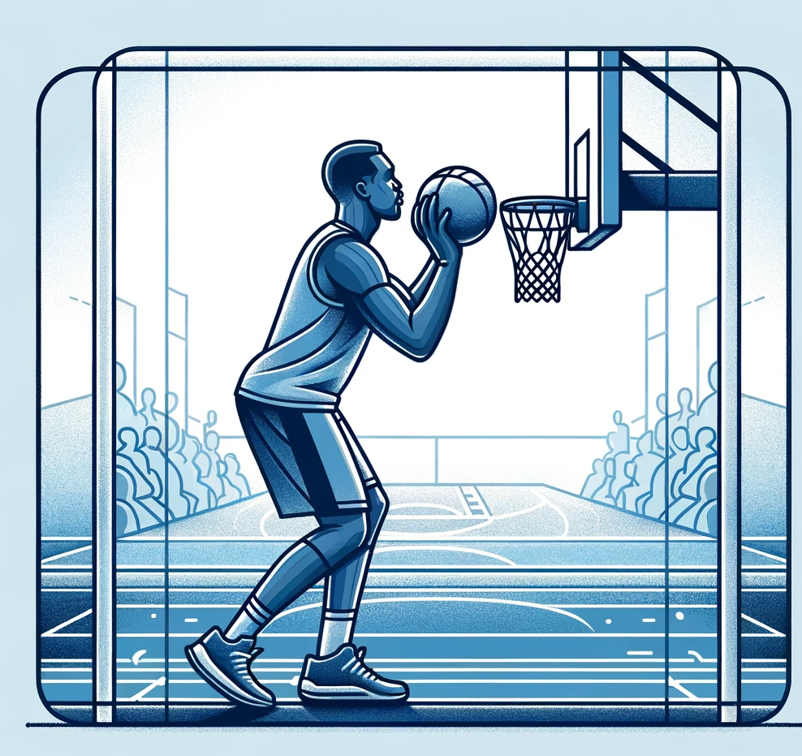
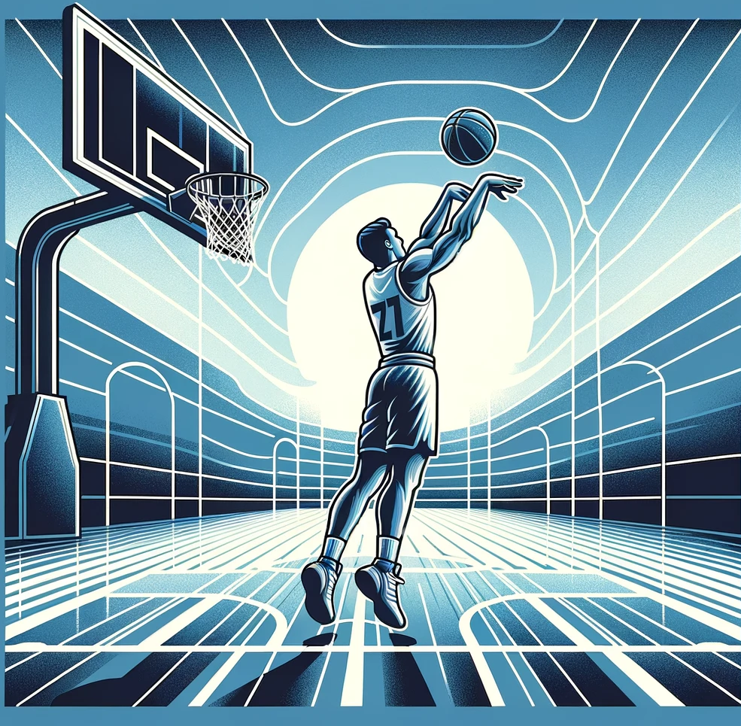

Home
About
Developers
Blog
Log in
Register
Free throws
3-Point throws
Visualization

Slide 2
Home
About
Developers
Blog
gbikushev
Upload video
Free throws
Video1.mp4
Throws: 20, Goals: 10, Misses: 10, Accuracy: 50%
20:54
Video2.mp4
Throws: 20, Goals: 10, Misses: 10, Accuracy: 50%
20:54
Video3.mp4
Throws: 20, Goals: 10, Misses: 10, Accuracy: 50%
20:54
Video4.mp4
Throws: 20, Goals: 10, Misses: 10, Accuracy: 50%
20:54
Video5.mp4
Throws: 20, Goals: 10, Misses: 10, Accuracy: 50%
20:54
Video6.mp4
Throws: 20, Goals: 10, Misses: 10, Accuracy: 50%
20:54

Slide 3
Home
About
Developers
Blog
Log in
Register
Upload video
3-Points throws
Video1.mp4
Throws: 20, Goals: 10, Misses: 10, Accuracy: 50%
20:54
Video2.mp4
Throws: 20, Goals: 10, Misses: 10, Accuracy: 50%
20:54
Video3.mp4
Throws: 20, Goals: 10, Misses: 10, Accuracy: 50%
20:54
Video4.mp4
Throws: 20, Goals: 10, Misses: 10, Accuracy: 50%
20:54
Video5.mp4
Throws: 20, Goals: 10, Misses: 10, Accuracy: 50%
20:54
Video6.mp4
Throws: 20, Goals: 10, Misses: 10, Accuracy: 50%
20:54

